Slide 1
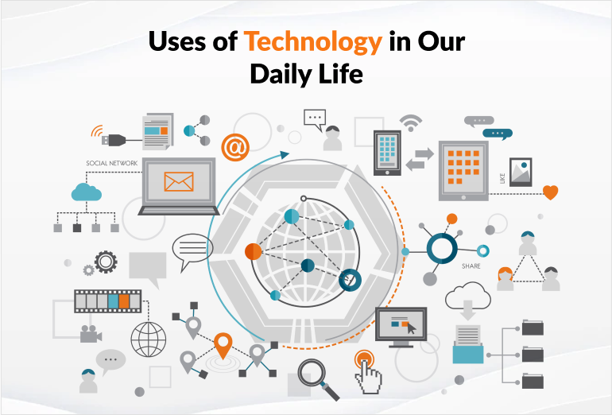
BEGINNER'S GUIDE
Applications of
Information andCommunication Technologies
Understanding How Technology Shapes Our Everyday World
4 Lectures • 30 Slides

Slide 2
COURSE OVERVIEW
What You Will Learn
01
Lecture 1
02
Lecture 2
Week 1
Week 1
ICT in Daily Life and Computer-Based Systems
Main Components of Computer Systems
School Systems
Banking
Medicine
Hardware
Software
Networks
03
Lecture 3
04
Lecture 4
Week 2
Week 2
Physical Components and Types of Computers
CPU and Memory Concepts
Desktop
Mobile
Mainframes
Processing
RAM
ROM

Slide 3
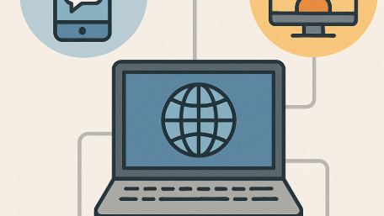
LECTURE 1 • WEEK 1
ICT in
Daily Life
Understanding how technology shapes our everyday world
8 Topics

Slide 4
LECTURE 1.1
The Role of ICT in Daily Life
What is ICT?
Information and Communication Technologies include computers, internet, mobile phones, and software used to handle information
Morning to Night
From alarm clocks to streaming movies, ICT is present in almost every activity throughout your day
Communication
Email, social media, video calls, and messaging apps keep us connected with friends and family worldwide
Information Access
Search engines and online resources provide instant access to knowledge, news, and educational content
Convenience
Online shopping, banking, and entertainment make life easier and save time for millions of people
Explanation
ICT is like the nervous system of modern society. Just as your nervous system connects all parts of your body, ICT connects people, businesses, and governments, making information flow quickly and efficiently.
Real-World Example: When you use WhatsApp to message a friend, search Google for homework help, or watch YouTube videos, you are using ICT!

Slide 5
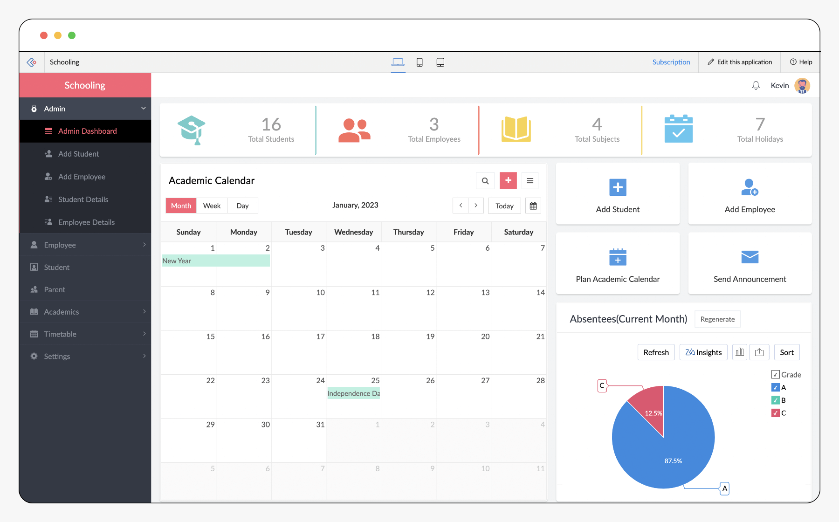
LECTURE 1.2
School Management Systems
Student Records
Store personal info, grades, attendance, and behavior reports digitally for easy access
Attendance Tracking
Automated systems mark attendance and alert parents when students are absent
Grade Management
Teachers enter grades online, and students/parents can view progress reports instantly
Timetable Scheduling
Software creates class schedules, assigns teachers to rooms, and avoids conflicts
Parent Communication
Send announcements, newsletters, and emergency alerts to parents via email or SMS
Example: Your school portal where you check grades, view homework, and see announcements is a school management system!
Explanation: School management systems are like digital assistants for schools. They handle paperwork automatically, so teachers can focus on teaching and students get better support.

Slide 6
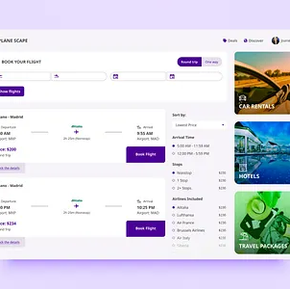
LECTURE 1.3
Booking Systems
Flight Reservations
Search flights, compare prices, select seats, and receive e-tickets instantly
Hotel Bookings
View room photos, check availability, read reviews, and confirm reservations online
Restaurant Tables
Reserve tables for dinner, choose time slots, and receive confirmation messages
Appointment Scheduling
Book doctor visits, haircuts, or consultations with automatic reminders
Secure Payments
Integrated payment systems handle credit cards and digital wallets safely
Explanation
Booking systems work like digital calendars that check availability in real-time. When you book a flight, the system instantly updates seats so two people cannot book the same seat!
Real-World Example: When you use Booking.com to reserve a hotel or Uber to book a ride, you are using a booking system!

Slide 7
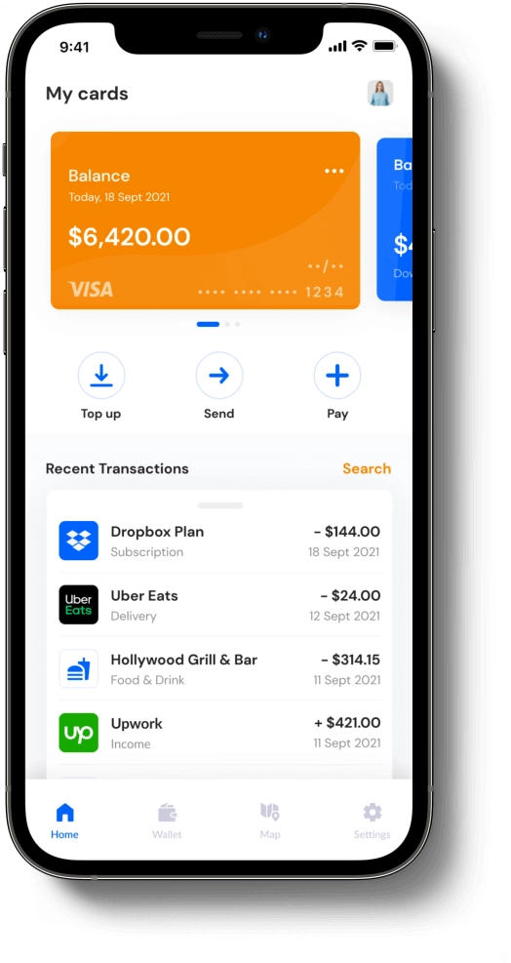
LECTURE 1.4
Banking Applications
Mobile Banking
Check balances, transfer money, and pay bills using smartphone apps from anywhere
Online Payments
Shop online securely using credit/debit cards, PayPal, Apple Pay, or Google Pay
ATM Transactions
Withdraw cash, deposit checks, and check account balances at automated machines
Security Features
Two-factor authentication, fingerprint login, and encryption protect your money
Financial Management
Track spending, set budgets, and receive alerts for unusual account activity
Example: Using your bank app to send money to a friend or pay for groceries with your phone is digital banking in action!
Explanation: Banking applications are like having a bank branch in your pocket. They use secure encryption (secret codes) to protect your money and personal information, making transactions safe and convenient.

Slide 8
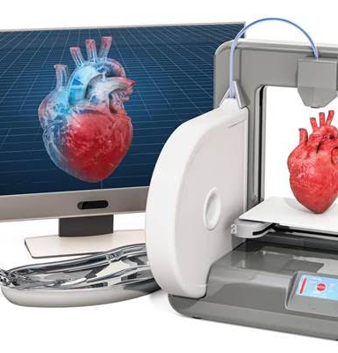
LECTURE 1.5
Computers in Medicine
Patient Records
Electronic Health Records (EHR) store medical history, prescriptions, and test results digitally
Medical Imaging
X-rays, CT scans, and MRIs use computers to create detailed images of the body
3D Printing
Create prosthetic limbs, dental implants, and organ models for surgical planning
Robotic Surgery
Surgeons use computer-controlled robots for precise, minimally invasive operations
Pharmacy Management
Track medication inventory, check drug interactions, and manage prescriptions
Explanation
Computers in medicine are like super-powered assistants. They help doctors see inside the body, plan surgeries, and create custom medical devices that fit each patient perfectly.
Real-World Example: Doctors using tablets to view X-rays, or hospitals 3D printing custom prosthetic hands for patients!

Slide 9
LECTURE 1.6
Expert Systems and Recognition Systems
Expert Systems
What they are: Computer programs that mimic human experts in specific fields
How they work: Use rules and data to make decisions and give advice
Examples: Medical diagnosis systems, financial advisors, troubleshooting guides
Biometric Security
Face and fingerprint recognition protect your devices and data
Recognition Systems
Face Recognition: Cameras identify people by analyzing facial features
Example: Unlocking your phone with your face, or using fingerprint to open a door!
Fingerprint Scanning: Sensors read unique patterns on fingertips for security
Expert systems are like having a doctor, financial advisor, or technician available 24/7 to answer questions and solve problems.
Uses: Unlock phones, airport security, banking authentication

Slide 10
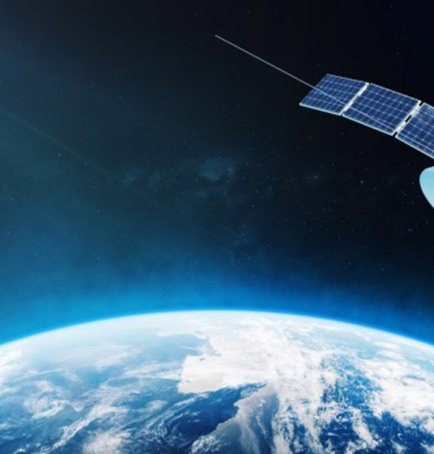
LECTURE 1.7
Retail Industry and Satellite Systems
Retail Industry Systems
Barcode Scanning: Quick checkout and inventory tracking
Inventory Management: Track stock levels automatically
Online Shopping: E-commerce websites and mobile apps
POS Systems: Process payments and generate receipts
Satellite Systems
GPS Navigation: Find locations and get directions
Weather Forecasting: Predict storms and climate patterns
Communication: TV signals, internet, and phone calls
Global Coverage: Connect remote areas worldwide
Explanation
Satellites are like eyes in the sky that watch over Earth. They help us navigate, predict weather, and stay connected no matter where we are.
Example: Supermarket self-checkout machines use barcode scanners, and Google Maps uses satellites to show your location!

Slide 11
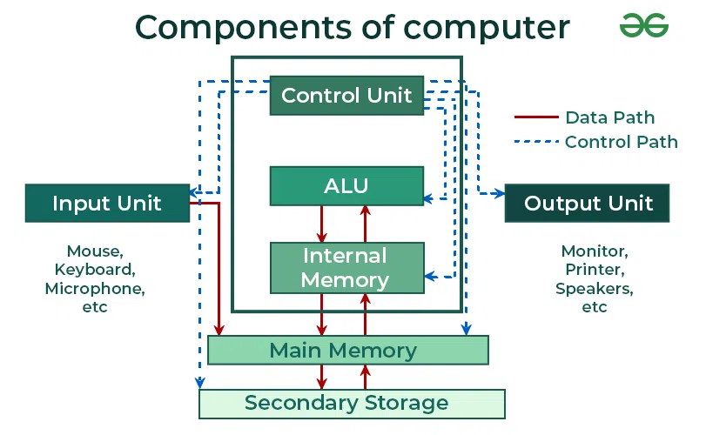
LECTURE 2 • WEEK 1
Main Components
of Computer Systems
Breaking down the essential parts that make computers work
5 Topics

Slide 12
LECTURE 2.1
Main Components Overview
Input Devices
Tools that send data and instructions into the computer
Examples: Keyboard, mouse, microphone, scanner, webcam
Computer System
Processing Unit (CPU)
Input → Process → Store → Output
The "brain" that processes instructions and performs calculations
Analogy: Like a chef following a recipe step by step
Example: When you type a document (input), the CPU processes it, saves it to the hard drive (storage), and displays it on screen (output)!
Storage Devices
Hardware that saves data permanently for later use
Think of a computer like a factory: raw materials (input) go in, workers process them (CPU), products are stored in a warehouse (storage), and finished goods are shipped out (output).
Examples: Hard drive, SSD, USB flash drive, cloud storage

Slide 13
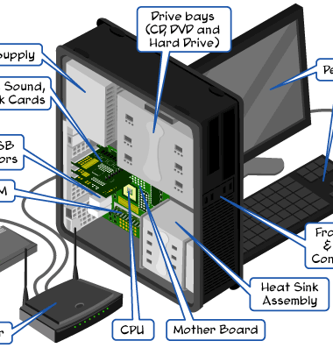
LECTURE 2.2
Physical Components
Hardware vs Software
Hardware = physical parts you can touch. Software = programs and instructions you cannot touch
Input Devices
Keyboard, mouse, scanner, microphone, webcam, touchscreen - devices that send data to the computer
Output Devices
Monitor, printer, speakers, projector - devices that show or produce results from the computer
Internal Components
CPU, RAM, motherboard, power supply, hard drive - parts inside the computer case
Peripherals
External devices connected to the computer: USB drives, external hard disks, headphones
Explanation
Physical components are the parts you can touch and see. They work together like the organs in a body, each with a specific job to keep the system running.
Real-World Example: Your computer setup at home - the monitor, keyboard, mouse, and the tower case containing the CPU and other parts are all physical components!

Slide 14
LECTURE 2.3
Computer-Based Systems
What is a Computer-Based System?
A complete setup that uses computers to solve real-world problems. It includes hardware, software, data, people, and procedures working together.
System Components
Hardware: Physical equipment
Software: Programs and applications
Hardware
Computers, servers, network
Data: Information to process
People: Users and operators
Software
Procedures: Rules and methods
Applications, operating systems
Data
Customer info, transactions
Example: An ATM machine is a computer-based system: it has hardware (screen, card reader), software (banking app), data (account info), and procedures (enter PIN, withdraw cash)!
Explanation: A computer-based system is like a restaurant kitchen. The hardware is the stove and fridge, software is the recipes, data is the ingredients, people are the chefs, and procedures are the cooking rules. All must work together to serve a meal!

Slide 15
LECTURE 2.4
Software and Programs
What is Software?
Software is a set of instructions that tells the computer what to do. Unlike hardware, you cannot touch software - it exists as code and programs.
System Software
Application Software
Software Layers
Operating Systems (Windows, macOS, Linux)
Word processors (Microsoft Word)
System Software → Application Software → User
Web browsers (Chrome, Firefox)
Device drivers
Games, photo editors, apps
Utility programs
Programs that help users perform specific tasks
Manages hardware and provides platform for applications
Explanation
Think of software like a car's controls. System software is the engine and steering system (makes the car work), while application software is the GPS or radio (helps you do specific things).
Real-World Example: Microsoft Word is application software for writing documents, while Windows is system software that runs the computer!

Slide 16
LECTURE 2.5
Communication Technologies
Computer Networks
Connect multiple computers together to share files, printers, and internet access
The Internet
A global network connecting billions of devices, enabling access to websites, email, and online services
Data Flow
Wireless Technologies
Device → Network → Internet → Destination
Wi-Fi, Bluetooth, and cellular networks (4G/5G) allow devices to connect without cables
Example: When you send a WhatsApp message, it travels through Wi-Fi → internet → your friend's phone in seconds!
Email and Messaging
Send text, images, and files instantly to anyone around the world
Communication technologies are like a postal system for digital data. Instead of physical letters, they deliver electronic messages, files, and information instantly across the world.
Cloud Services
Store files and run applications on remote servers accessible from anywhere

Slide 17
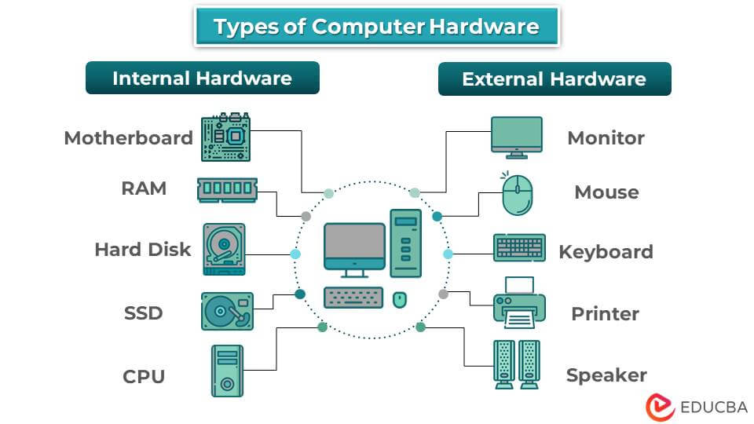
LECTURE 3 • WEEK 2
Physical Components
and Types of Computers
Exploring the different machines that power our digital world
5 Topics

Slide 18
LECTURE 3.1
Physical Components of Computer Systems
Motherboard
Power Supply
Storage Drives
The main circuit board that connects all components together
Converts electricity from the wall to power all computer parts
Hard Disk Drives (HDD) and Solid State Drives (SSD) store data permanently
Analogy: Like a city's highway system connecting all neighborhoods
Analogy: Like a heart pumping blood to all body organs
Capacity: 256GB to several terabytes
RAM Modules
Cooling System
Expansion Cards
Temporary memory that stores active programs and data while computer is on
Fans and heat sinks prevent overheating by dissipating heat from CPU and components
Graphics cards, sound cards, and network cards add extra capabilities to the computer
Speed: Much faster than storage drives
Importance: Keeps system stable and reliable
Example: Gaming requires powerful graphics cards
Real-World Example: When you open a game, the CPU processes graphics, RAM stores game data temporarily, the graphics card renders images, and the cooling system keeps everything from overheating!

Slide 19
LECTURE 3.2
Desktop Computers
What They Are
Personal computers designed to stay in one place, consisting of a tower case, monitor, keyboard, and mouse
Powerful Performance
Can handle demanding tasks like video editing, gaming, and software development with high-speed processors
Desktop Computer
Easy to Upgrade
Powerful and upgradeable
Add more RAM, replace graphics cards, or install larger storage drives as needs change
Cost-Effective
Offer the best performance per dollar compared to other computer types
Common Uses
Offices, schools, homes, gaming centers, and design studios
Explanation
Desktop computers are like powerful workstations. They offer the best performance for the price and can be customized with better parts over time, making them ideal for demanding tasks.
Real-World Example: The computer in your school's computer lab with a separate monitor, keyboard, and tower case is a desktop computer!

Slide 20
LECTURE 3.3
Mobile Computers
Laptops
Tablets
Smartphones
Portable computers with built-in screen and keyboard
Touchscreen devices, lightweight and thin
Pocket-sized computers with phone capabilities
Great for reading, browsing, and media
Battery-powered for use anywhere
iPads, Android tablets, and Surface devices
Apps for every need: social, work, entertainment
Ideal for students and professionals on the go
Cameras, GPS, and sensors built-in
Advantages of Mobile Computers
Real-World Example: Using your smartphone to check email on the bus, or a student taking notes on a laptop in class - these are mobile computers in action!
✓ Work from anywhere
✓ Stay connected on the go
Mobile computers are like digital Swiss Army knives - they pack powerful computing into portable devices that fit our mobile lifestyles.
✓ Lightweight and convenient
✓ Long battery life

Slide 21
LECTURE 3.4
Mainframes
What They Are
Massive, powerful computers used by large organizations to process enormous amounts of data
High Performance
Can process millions of transactions per second with extreme reliability and speed
Reliability
Mainframe Computer
Designed to run 24/7 without stopping, with backup systems to prevent data loss
Room-sized powerhouse
Multi-User Support
Thousands of users can access the system simultaneously without slowing down
Who Uses Them
Banks, airlines, government agencies, hospitals, and large corporations
Explanation
Mainframes are like super-powered office managers. While a desktop handles one person's work, a mainframe manages millions of transactions for thousands of people simultaneously, never taking a break!
Real-World Example: When you withdraw money from an ATM, the bank's mainframe processes your request, checks your balance, and updates your account in milliseconds!

Slide 22
LECTURE 3.5
Comparing Types of Computers
Feature | Desktop | Mobile | Mainframe
Portability | Not portable | Highly portable | Not portable
Power | High | Moderate | Extremely high
Cost | $500-$2000 | $200-$2500 | $100,000+
Users | 1 person | 1 person | Thousands
Best For | Gaming, office work | Travel, flexibility | Banks, airlines
Which One Should You Choose?
Example: A graphic designer uses a powerful desktop, a student uses a laptop for classes, and your bank uses a mainframe to process all customer transactions!
Desktop: Best for power users, gamers, and office work
Mobile: Perfect for students, travelers, and casual use
Think of computers like vehicles: desktops are trucks (powerful but stationary), mobile devices are cars (versatile and portable), and mainframes are trains (handle massive loads for many people).
Mainframe: Essential for large organizations handling massive data

Slide 23
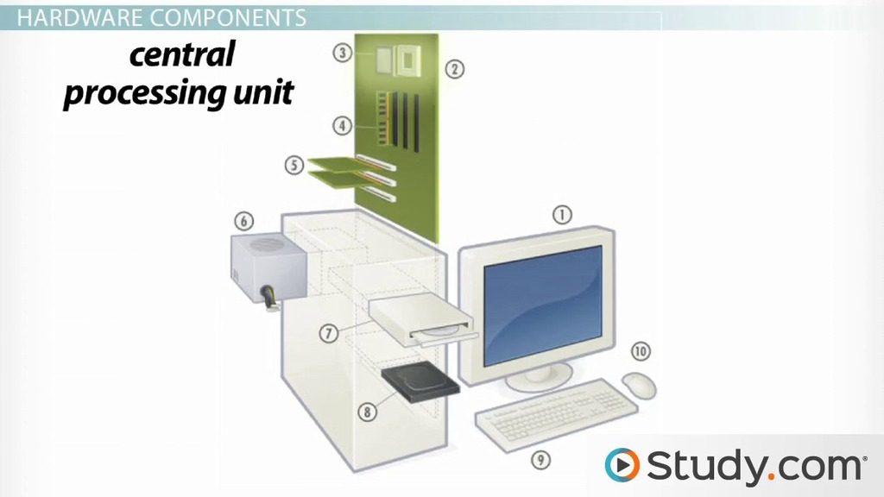
LECTURE 4 • WEEK 2
CPU and
Memory Concepts
Understanding the brain and memory of computers
6 Topics

Slide 24
LECTURE 4.1
Central Processing Unit (CPU)
What is the CPU?
The CPU is the "brain" of the computer. It executes instructions, performs calculations, and coordinates all other components.
Analogy: Like a chef in a kitchen who reads recipes, prepares ingredients, and creates dishes
CPU Chip
The brain of your computer
Main CPU Components
Control Unit (CU): Directs operations, like a traffic controller
Example: When you click a button, the CPU processes that action in milliseconds, updating the screen and performing calculations!
Arithmetic Logic Unit (ALU): Performs math and logical operations
The CPU speed is measured in GHz (gigahertz). A 3 GHz CPU performs 3 billion cycles per second - that's incredibly fast!
Registers: Tiny, super-fast memory storage inside CPU

Slide 25
LECTURE 4.2
Role of CPU in Processing Instructions
The Fetch-Decode-Execute Cycle
1
Fetch
CPU retrieves instruction from memory (RAM)
2
Decode
CPU understands what the instruction means
3
Execute
Processing Cycle
CPU performs the action (calculation, data move)
Fetch → Decode → Execute → Store
4
Store
CPU saves the result back to memory
Input-Process-Output Model
Input
Process
Output
Explanation
Type, click, scan
CPU works
See result
The CPU works like a super-fast factory worker. It reads instructions (fetch), understands them (decode), does the work (execute), and puts away the finished product (store) - repeating this billions of times per second!
Real-World Example: When you press a key (input), the CPU fetches the key code, decodes which letter it is, displays it on screen (output) - all in less than a millisecond!

Slide 26
LECTURE 4.3
Internal Memory Overview
What is Internal Memory?
Memory is where the computer stores data and instructions temporarily while working. It's like a workspace where the CPU keeps information it needs right now.
Memory Hierarchy
Analogy: Like your desk - you keep papers you're currently working on there, but file away completed work
Cache (Fastest)
Smallest, nearest to CPU
RAM (Fast)
Types of Internal Memory
Temporary workspace
RAM (Random Access Memory): Temporary, volatile memory
Storage (Slow)
ROM (Read Only Memory): Permanent, non-volatile memory
Permanent, large capacity
Cache Memory: Super-fast memory near the CPU
Example: When you open multiple browser tabs, RAM stores the web pages so you can switch between them quickly!

Slide 27
LECTURE 4.4
Cache Memory
What is Cache Memory?
Super-fast memory located very close to the CPU that stores frequently used data and instructions
Why is it Fast?
Cache is built directly into or very near the CPU chip, so data travels a much shorter distance
Cache Levels
Cache Memory
L1 (fastest, smallest), L2 (medium), L3 (larger, shared). Like having small, medium, and large notebooks
Super-fast access
Performance Boost
Reduces the time CPU waits for data, making programs run faster and more efficiently
Cost
More expensive than RAM, so computers have smaller amounts (KB to MB range)
Explanation
Cache memory is like keeping your most-used tools on your desk instead of in a toolbox. The CPU can grab frequently used data instantly without searching through slower RAM.
Real-World Example: When you visit the same website daily, your browser caches images so they load instantly instead of downloading each time!

Slide 28
LECTURE 4.5
RAM: Random Access Memory
What is RAM?
Temporary memory that stores active programs and data while the computer is running. It's volatile - data disappears when power is off.
Analogy: Short-Term Memory
Like your brain remembering a phone number temporarily. RAM holds information the CPU needs right now.
RAM Module
Speed Matters
Temporary workspace
More RAM means better multitasking. You can run more programs simultaneously without slowdown.
Capacity
Measured in GB (gigabytes). Common sizes: 4GB, 8GB, 16GB, 32GB. More is better for demanding tasks.
Example: Opening 20 browser tabs uses RAM. If RAM is full, the computer slows down because it can't hold all that data!
Volatility
Think of RAM as your desk space. A bigger desk lets you spread out more papers and work on multiple projects at once without constantly filing and retrieving.
When you turn off the computer, RAM clears completely. That's why you must save files to storage!

Slide 29
LECTURE 4.6
ROM: Read Only Memory
What is ROM?
Permanent memory that stores essential instructions for starting the computer. Data cannot be easily changed or deleted.
Non-Volatile
ROM keeps its data even when the computer is turned off. It's like permanent instructions written in stone.
ROM Chip
Boot Instructions
Stores BIOS/UEFI - the program that wakes up the computer, checks hardware, and loads the operating system
Permanent instructions
Read-Only
Normal users cannot write to ROM. It's factory-programmed with critical system software
Types of ROM
PROM (programmable once), EPROM (erasable with UV light), EEPROM (electrically erasable, like flash memory)
Explanation
ROM is like the instruction manual that comes with a toy - it's already written, you can't change it, and it tells you how to get started. Every time you turn on your computer, ROM reads this "manual" to know what to do first.
Real-World Example: When you press the power button, ROM tells the computer how to wake up, test its parts, and start Windows or macOS!

Slide 30
CONGRATULATIONS!
What You've Learned
Your journey through the world of ICT
ICT in Daily Life
Computer-Based Systems
Understand how technology impacts communication, work, shopping, banking, and entertainment
Recognize different systems used in schools, hospitals, banks, retail, and security
Computer Components
Types of Computers
Identify hardware, software, input/output devices, and communication technologies
Distinguish between desktops, mobile devices, and mainframes and their uses
CPU and Memory
Understand how the CPU processes instructions, the role of cache, RAM, and ROM, and how they work together
Keep Exploring the World of Technology!
The digital world is full of exciting opportunities to learn and grow.

